Slide 1
Multithreading
POSIX Thread IEEE 1003.1c

Slide 2
Contents
Multitasking vs Multithreading
Process
Threads
Why Threading
POSIX Threads
POSIX Thread APIs
Creating and Terminating Threads
Joining and Detaching Threads
Mutual Exclusion

Slide 3
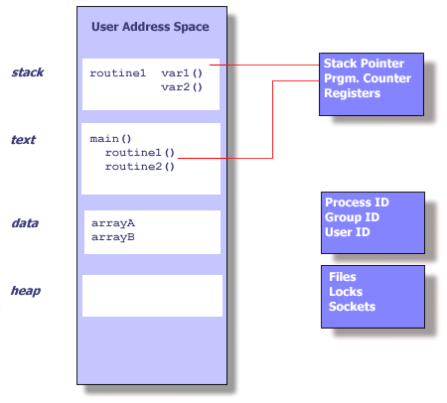
Process

Slide 4
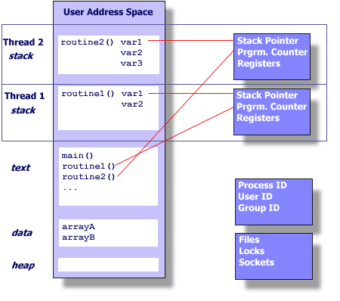
Thread

Slide 5
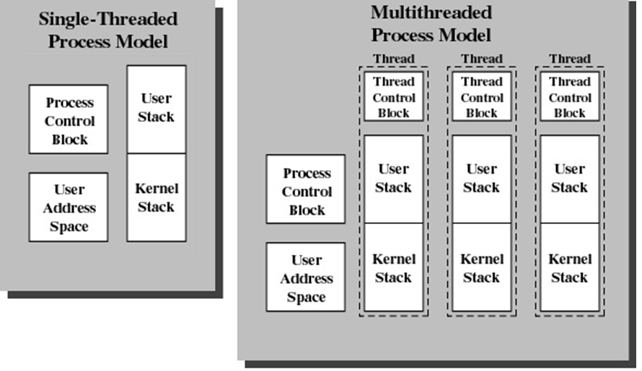
Multitasking vs Multithreading

Slide 6
Why Threading
Multitasking
fork()
Problems
Time to create new process
Memory requirements
Switching Time for scheduling
Solution
Multithreading
pthread_create()

Slide 7
Creating a new Process
pid = fork()
if ( pid < 0 )
{ printf ("fork failed,Error = %d\n", pid); exit(0); }
else if (pid ==0) /* this is the child of the fork */
{ do_nothing(); exit(0); }
else /* this is the parent of the fork */
{ waitpid(pid, status, 0); }

Slide 8
Creation Time
50,000 processes or threads creation time in seconds
Platform | fork() | pthread_create()
Intel 2.6 GHz Xeon E5-2670 (16cpus/node) | 8.1 | 0.9
Intel 2.8 GHz Xeon 5660 (12cpus/node) | 4.4 | 0.7
AMD 2.3 GHz Opteron (16cpus/node) | 12.5 | 1.2
AMD 2.4 GHz Opteron (8cpus/node) | 17.6 | 1.4
IBM 4.0 GHz POWER6 (8cpus/node) | 9.5 | 1.6
IBM 1.9 GHz POWER5 p5-575 (8cpus/node) | 64.2 | 1.7
IBM 1.5 GHz POWER4 (8cpus/node) | 104.5 | 2.1
INTEL 2.4 GHz Xeon (2 cpus/node) | 54.9 | 1.6
INTEL 1.4 GHz Itanium2 (4 cpus/node) | 54.5 | 2

Slide 9
Benefits of Threads
Less time to
create a new thread than a process
terminate a thread than a process
switch between two threads within the same process
Since threads within the same process share memory and files, they can communicate with each other without invoking the kernel

Slide 10
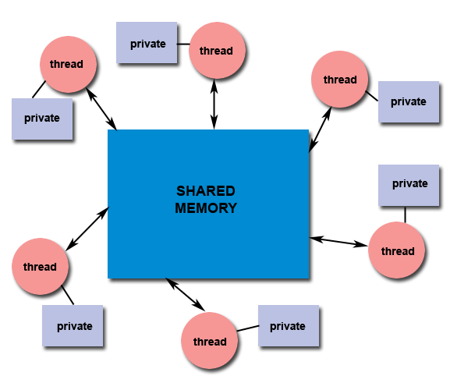
Shared Memory
All threads have access to the same global, shared memory
Threads also have their own private data
Programmers are responsible for synchronizing access (protecting) globally shared data.

Slide 11
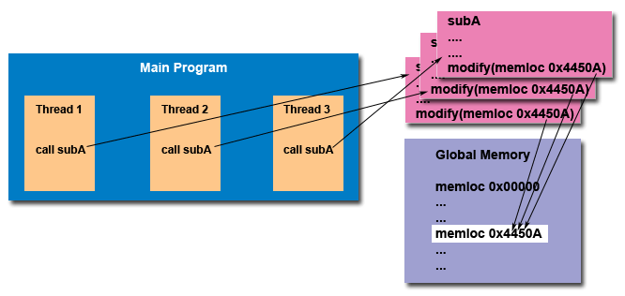
“Thread Safe”

Slide 12
POSIX Threads
Historically, hardware vendors have implemented their own proprietary versions of threads.
These implementations differed substantially from each other making it difficult for programmers to develop portable threaded applications
In order to take full advantage of the capabilities provided by threads, a standardized programming interface was required
For UNIX systems, this interface has been specified by the IEEE POSIX 1003.1c standard (1995).
Latest version (IEEE POSIX 1003.1-2008)

Slide 13
POSIX Thread APIs
Thread management:
creating, detaching, joining
Mutexes:
"mutual exclusion”
creating, destroying, locking and unlocking mutex
Condition variables:
communications between threads that share a mutex
wait and signal
Synchronization:
read/write locks and barriers.

Slide 14
Thread management
Creating and Terminating Threads
pthread_create (thread, attr, start_routine, arg)
pthread_exit (status)
pthread_cancel (thread)
pthread_attr_init (attr)
pthread_attr_destroy (attr)

Slide 15
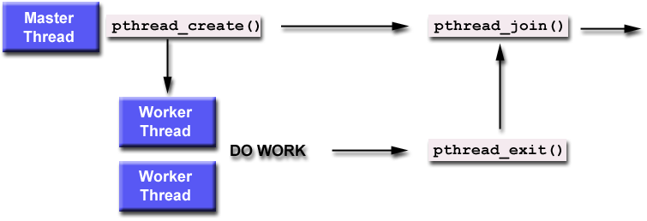
Thread management
Joining and Detaching Threads
pthread_join (threadid,status)
pthread_detach (threadid)
pthread_attr_setdetachstate (attr,detachstate)
pthread_attr_getdetachstate (attr,detachstate)

Slide 16
Joinable vs Detachable
A joinable thread, is a thread that can, and should, be joined - waited for its termination. Such a thread is equivalent to a process which is expected to yield a value that should be collected by some other process (reaping). Similarly to such processes, a joinable thread becomes a zombie after finishing, and won't disappear until joined.
An alternative to a joinable thread is a detached thread that is not expected to be joined; such a thread disappears immediately after termination.
By default, a thread starts as joinable. It can become detached with the pthread_detach() call. The pthread_join() call is used to join a thread.

Slide 17
thread_1.c
#include <stdio.h>
#include <pthread.h>
#include <unistd.h>
void * work(void * ptr)
{ int i;
for (i = 0; i < 10; i++){ printf("%d", (int)ptr); usleep(1000); }
pthread_exit(0);
}
int main(int argc, char ** argv)
{
pthread_t t0, t1;
pthread_create(&t0, 0, work, (void *)0);
pthread_create(&t1, 0, work, (void *)1);
pthread_join(t0, 0);
pthread_join(t1, 0);
return 0;
}

Slide 18
Joinable Threads
void *do_nothing(void *null) { int i; i=0; pthread_exit(NULL); }
int main(int argc, char *argv[]) {
pthread_t tid;
pthread_attr_t attr;
pthread_attr_init(&attr);
pthread_attr_setdetachstate(&attr, PTHREAD_CREATE_JOINABLE);
rc = pthread_create(&tid, &attr, do_nothing, NULL);
if (rc) { printf("ERROR Code = %d\n", rc); exit(-1); }
/* Wait for the thread */
rc = pthread_join(tid, NULL);
if (rc) {printf("ERROR Code = %d\n", rc); exit(-1); }
pthread_attr_destroy(&attr);
pthread_exit(NULL);

Slide 19
How to pass multiple arguments to a thread
struct thread_data { int thread_id; int sum; char *message; }; struct thread_data data;
void *PrintHello(void *threadarg) { struct thread_data *my_data; ... my_data = (struct thread_data *) threadarg; taskid = my_data->thread_id; sum = my_data->sum; hello_msg = my_data->message; ... } | int main (int argc, char *argv[]) { ... data.thread_id = tid; data.sum = sum; data.message = messages; rc = pthread_create(&thread, NULL, PrintHello, (void *) &data); ... }

Slide 20
Mutual Exclusion
To protect shared resources from race condition and data inconsistency.
Thread 1 | Thread 2 | Shared Data X
A = X |  | 100
 | B = X | 100
 | B = B + 300 | 100
A = A + 200 |  | 100
X = A |  | 300
 | X = B | 400

Slide 21
Mutex
Structure
pthread_mutex_t
Fuctions
pthread_mutex_init (mutex , attr)
pthread_mutex_destroy (mutex)
pthread_mutexattr_init (attr)
pthread_mutexattr_destroy (attr)

Slide 22
Locking and Unlocking Mutex
Functions
pthread_mutex_lock (mutex)
pthread_mutex_unlock (mutex)
pthread_mutex_trylock (mutex)

Slide 23
Example : Mutex Lock/Unlock
pthread_mutex_t mtx;
void print(int thread, int i) { pthread_mutex_lock(&mtx); // < Critical Section > printf("thread %d: %d\n", thread, i); pthread_mutex_unlock(&mtx); } | void * work(void * ptr) { for (int i = 0; i < 10; i++) print((int)ptr, i); pthread_exit(0); }
int main(int argc, char ** argv) { pthread_t t0, t1; pthread_mutex_init(&mtx, 0); pthread_create(&t0, 0, work, (void *)0); pthread_create(&t1, 0, work, (void *)1); pthread_join(t0, 0); pthread_join(t1, 0); pthread_mutex_destroy(&mtx); return 0; }

Slide 24
Thread Synchronization
When two or more threads are dependents on each other
Signaling a sleeping threads to wakeup
POSIX Threads support
Condition Variables

Slide 25
Condition Variables
Condition variables provide yet another way for threads to synchronize. While mutexes implement synchronization by controlling thread access to data, condition variables allow threads to synchronize based upon the actual value of data.
Without condition variables, the programmer would need to have threads continually polling (possibly in a critical section), to check if the condition is met. This can be very resource consuming since the thread would be continuously busy in this activity. A condition variable is a way to achieve the same goal without polling.
A condition variable is always used in conjunction with a mutex lock.

Slide 26
Condition Variables
Structure
pthread_cond_t
Functions
pthread_cond_init (condition , attr)
pthread_cond_destroy (condition)
pthread_condattr_init (attr)
pthread_condattr_destroy (attr)

Slide 27
Wait & Signal
Functions
pthread_cond_wait (condition , mutex)
pthread_cond_signal (condition)
pthread_cond_broadcast (condition)

Slide 28
Example : Wait & Signal
pthread_mutex_t mtx; pthread_cond_t cond; int how_many = 10; int pool = 0;
int main(int argc, char ** argv) { pthread_t prod, cons; pthread_mutex_init(&mtx, 0); pthread_cond_init(&cond, 0); pthread_create(&cons, 0, consumer, 0); pthread_create(&prod, 0, producer, 0); pthread_join(prod, 0); pthread_join(cons, 0); pthread_cond_destroy(&cond); pthread_mutex_destroy(&mtx); return 0; }

Slide 29
Example : Wait & Signal
pthread_mutex_t mtx; pthread_cond_t cond; int how_many = 10; int pool = 0;
void * producer(void * ptr) { while (how_many > 0) { pthread_mutex_lock(&mtx); printf("producer: %d\n", how_many); pool = how_many; how_many--; pthread_mutex_unlock(&mtx); pthread_cond_signal(&cond); } pthread_exit(0); } | void * consumer(void * ptr) { while (how_many > 0) { pthread_mutex_lock(&mtx); pthread_cond_wait(&cond, &mtx); printf("consumer: %d\n", pool); pool = 0; pthread_mutex_unlock(&mtx); } pthread_exit(0); }

